Slide 1
Unit- IV Visualization Using Seaborn

Slide 2
Introduction
Seaborn is a powerful Python library built on top of Matplotlib that provides a high-level interface for creating informative and attractive statistical graphics.
It simplifies the process of creating complex visualizations and integrates well with pandas DataFrames.

Slide 3
Key Features of Seaborn:
Statistical Plots: Seaborn offers a variety of functions to easily create plots that visualize the statistical relationships in data, including regression lines, confidence intervals, and distribution plots.
Integrated with Pandas: Seaborn works seamlessly with pandas DataFrames, making it easy to visualize data directly from DataFrames.
Themes and Color Palettes: Seaborn provides built-in themes and color palettes to make it easier to create aesthetically pleasing plots.
Complex Plots: It allows for the creation of more complex plots, such as violin plots, pair plots, and heatmaps, with less code compared to Matplotlib.

Slide 4
R programming
It has become one of the best data analytics tools especially when it comes for visual analytics.
A great community contribution makes it easier to learn, use and share for the effective visualization.
It is imperative to say that proper visualization is a very important factor for data scientists & AI specialists.
Even if you are only interested to work with business communication with impactful visualizations, R can provide you a comprehensive way of work where you have full freedom to play with your data and create useful graphs for your audiences. It is an open-sourced tool by the way.
RStudio is the most favorable IDE(Integrated Development Environment) for R.

Slide 5
R is a popular open-source programming language for statistical computing and data analysis. R typically includes a command-line interface. R supports not only branching and looping but also modular programming via functions. To boost efficiency, R can be integrated with procedures written in C, C++, .Net, Python, and FORTRAN.
For data analysis, R programming is a scripting language that supports a number of statistical analysis methods, machine learning models, and graphical visualizations.
It is an open-source programming language with a sizable user base. Learning and using the R programming language is easy. You can build an effective R program, data models, and graphical charts using a variety of built-in functions and support packages. In the modern world, data analysts, statisticians, and marketers frequently use R as a tool for accessing, cleaning, and presenting data.

Slide 6
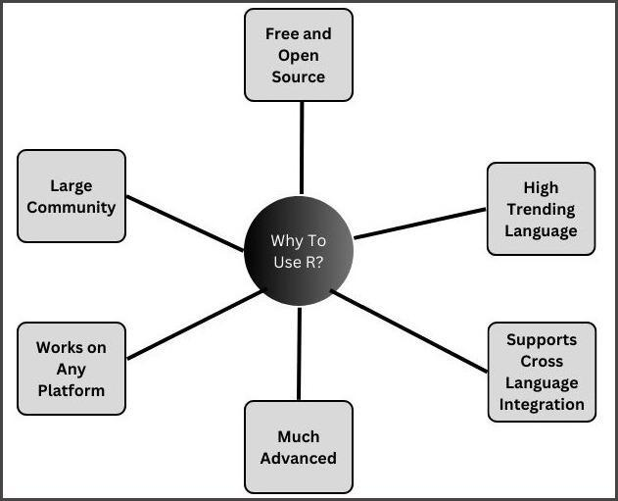
Why R is used

Slide 7
ggplot2
ggplot2 is the most popular data visualization package in the R community.
It was implemented based on Leland Wilkinson’s Grammar of Graphics — a general scheme for data visualization which breaks up graphs into semantic components such as scales and layers.
While using ggplot2, you provide the data, call specific function, map your desired variables to aesthetics, define graphical arguments.

Slide 8
tidyverse
tidyverse is a collecttion of packages for data science introduced by the same Hadley Wickham. ‘tidyverse’ encapsulates the ‘ggplot2’ along with other packages for data wrangling and data discoveries.

Slide 9
Install Packages
If you install tidyverse, then you do not need to install ggplot2 separately!
# install.packages('ggplot2')
install.packages('tidyverse')
install.packages("ggalt")
install.packages('GGally')
install.packages('ggridges')

Slide 10
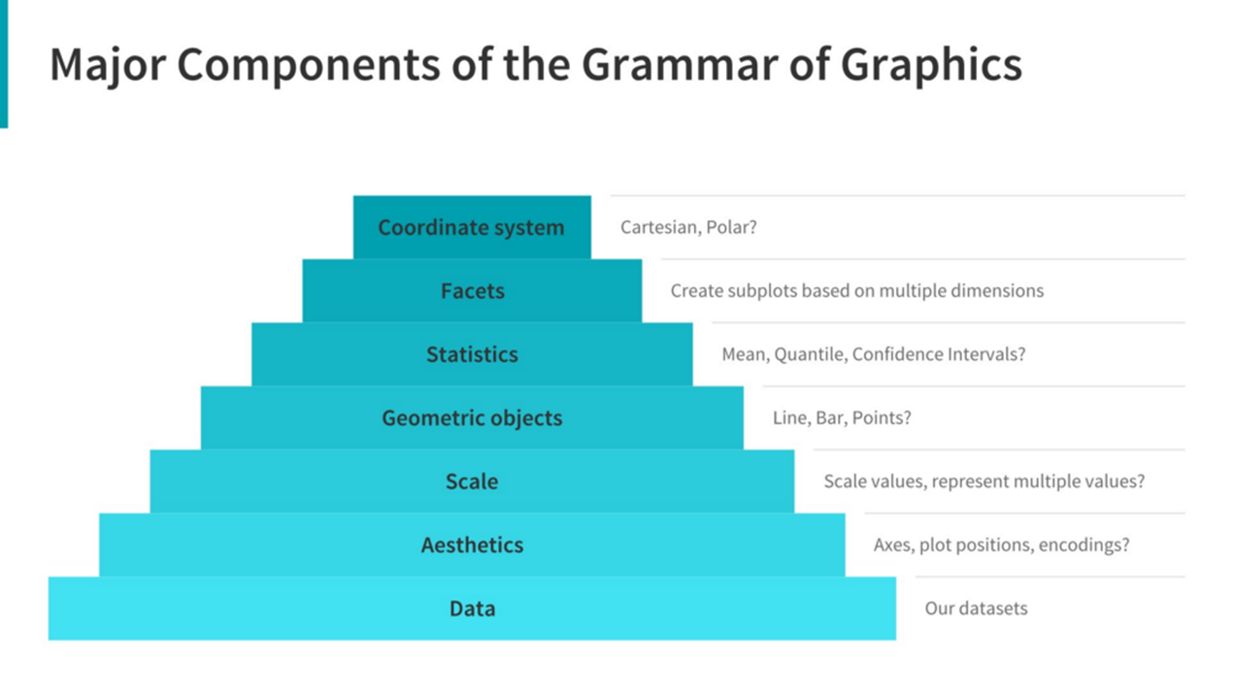
How ggplot2 works:
The Grammar of Graphics Stemming from Leland Wilkinson's Grammar of Graphics, building plots with ggplot follows a very structured framework where different components stack upon each other to form our final graph.

Slide 11
Moving from most to least essential, the components which make up a graph are:
Data: In order to plot something, we need to have the underlying dataset!
Aesthetics: Here we specify how we want our data to map onto our plot. Which variable belongs on the x-axis? What about the y-axis? Are we going to convey additional dimensions of data with colour, or shape, or opacity?
Scale: When setting scales, we need to allow for easy data visualisation. Most of the time we'll use a linear scale, but can also use other options such as geometric, or logarithmic, if the data is distributed differently and would better suit these transformations.
Geometric Objects: These are the way that the data is represented on our graphs (think points, lines, bars, etc..) In ggplot, the name is frequently shortened to geom.
Statistics: We also need to think about summarising our data. Sure, we could plot everything if we want to, but often that will leave a resulting graph cluttered and confusing, particulary if we want to compare groups that have some overlap or variance.
Facets: Speaking of groups, does ti make sens to plot everything on the one graph, or would smaller subgraphs for data in different categories be a better match?
Coordinate System: This has only come up very rarely for me, but ggplot has the capacities to plot onto coordinates that aren't just an x-y plane, for all you pie chart lovers out there.

Slide 12
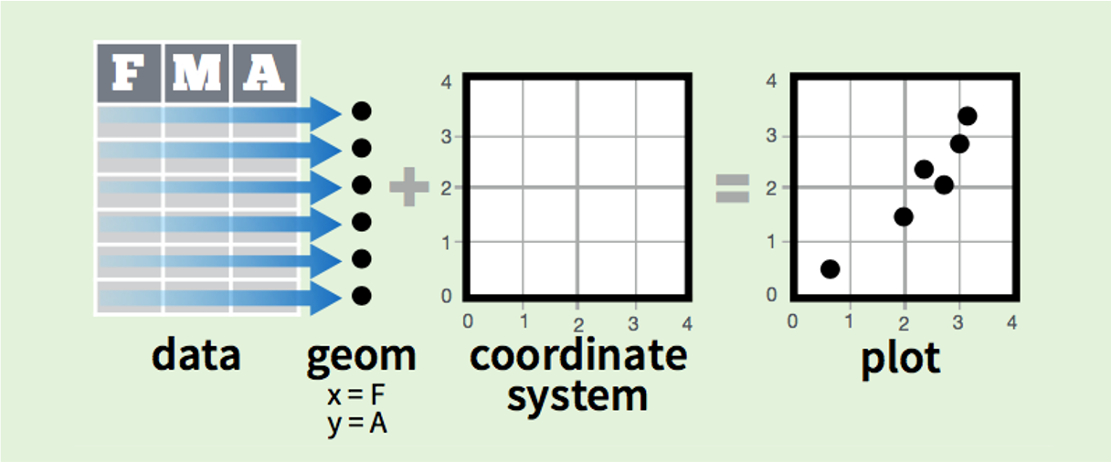
In practice, we can put these elements together a little like this:

Slide 13
Variable Names
A variable can have a short name (like x and y) or a more descriptive name (age, carname, total_volume). Rules for R variables are:
A variable name must start with a letter and can be a combination of letters, digits, period(.)
and underscore(_). If it starts with period(.), it cannot be followed by a digit.
A variable name cannot start with a number or underscore (_)
Variable names are case-sensitive (age, Age and AGE are three different variables)
Reserved words cannot be used as variables (TRUE, FALSE, NULL, if...)

Slide 14
# Legal variable names: myvar <- "John" my_var <- "John" myVar <- "John" MYVAR <- "John" myvar2 <- "John" .myvar <- "John" # Illegal variable names: 2myvar <- "John" my-var <- "John" my var <- "John" _my_var <- "John" my_v@ar <- "John" TRUE <- "John"

Slide 15
Basic Data Types
Basic data types in R can be divided into the following types:
numeric - (10.5, 55, 787)
integer - (1L, 55L, 100L, where the letter "L" declares this as an integer)
complex - (9 + 3i, where "i" is the imaginary part)
character (a.k.a. string) - ("k", "R is exciting", "FALSE", "11.5")
logical (a.k.a. boolean) - (TRUE or FALSE)

Slide 16
# numeric
x <- 10.5
print(class(x))
# integer
x <- 1000L
print(class(x))
# complex
x <- 9i + 3print(class(x))
# character/ string
x <- "R is exciting“
print(class(x))
# logical/Boolean
x <- TRUE
print(class(x))

Slide 17
R Data Structures

Slide 18
Vectors in R Programming
In R, a vector is one of the most basic data structures. It is a sequence of elements that are all of the same type. Vectors can contain numeric, character, logical, or other types of data.

Slide 19
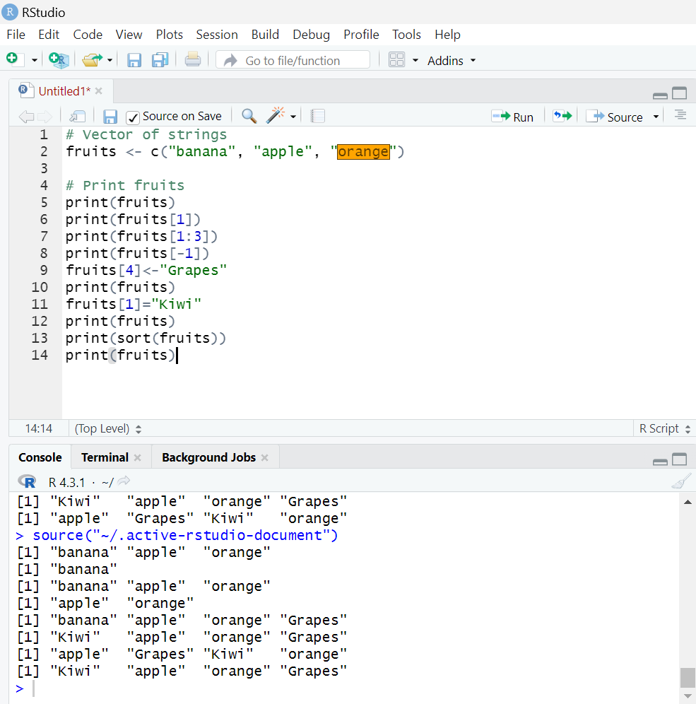

Slide 20
Lists
A list in R can contain many different data types inside it. A list is a collection of data which is ordered and changeable.
To create a list, use the list() function:
list1<-list("Ram",1L,98.54)
print(list1)
print(list1[2])
list1[1]<-"Rajesh“
print(list1)
list1<-append(list1,"Ramesh")
print(list1)
print(append(list1,"Ramesh",after=1))
print(list1)

Slide 21
R Matrices
A matrix is a two dimensional data set with columns and rows.
A column is a vertical representation of data, while a row is a horizontal representation of data.
A matrix can be created with the matrix() function. Specify the nrow and ncol parameters to get the amount of rows and columns:

Slide 22
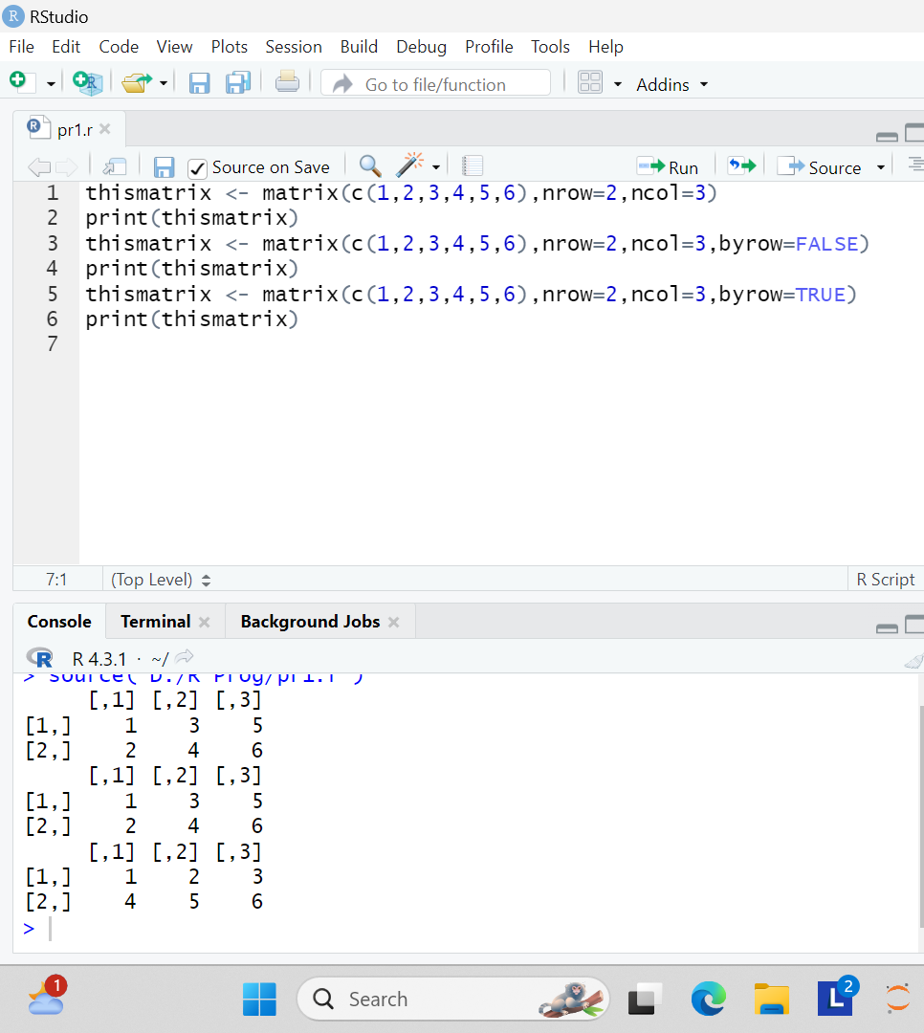

Slide 23
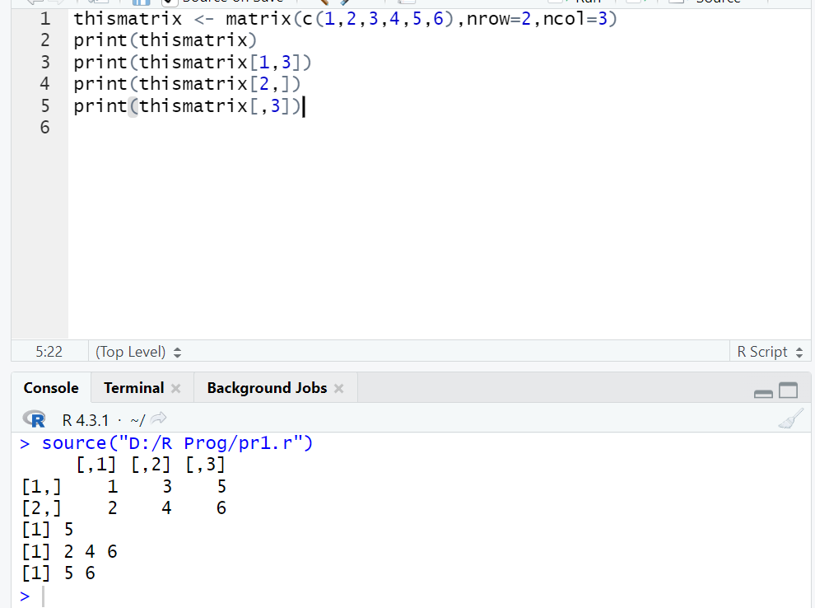

Slide 24
R Arrays
Compared to matrices, arrays can have more than two dimensions.
We can use the array() function to create an array, and the dim parameter to specify the dimensions:

Slide 25
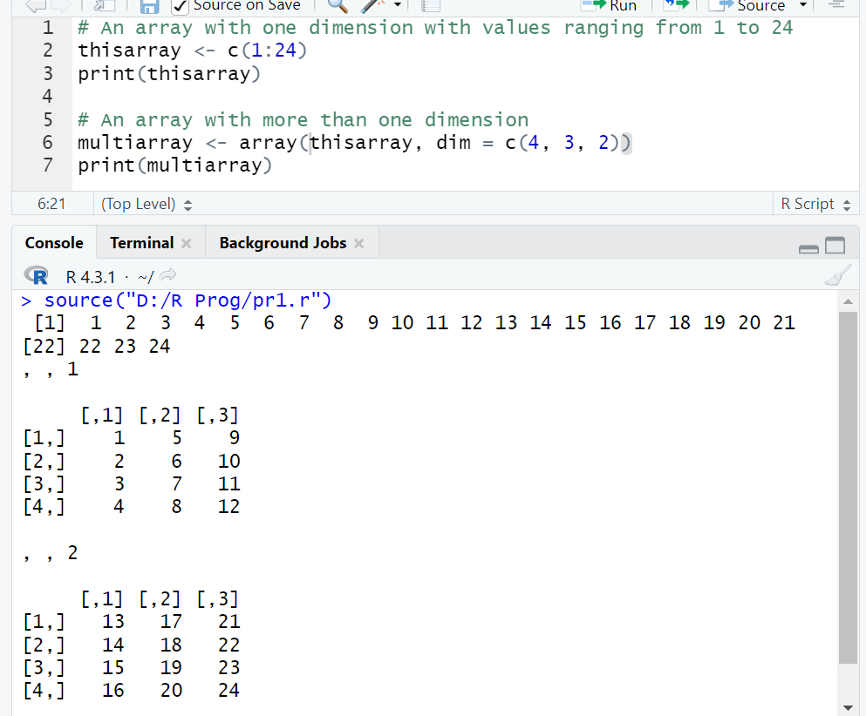

Slide 26
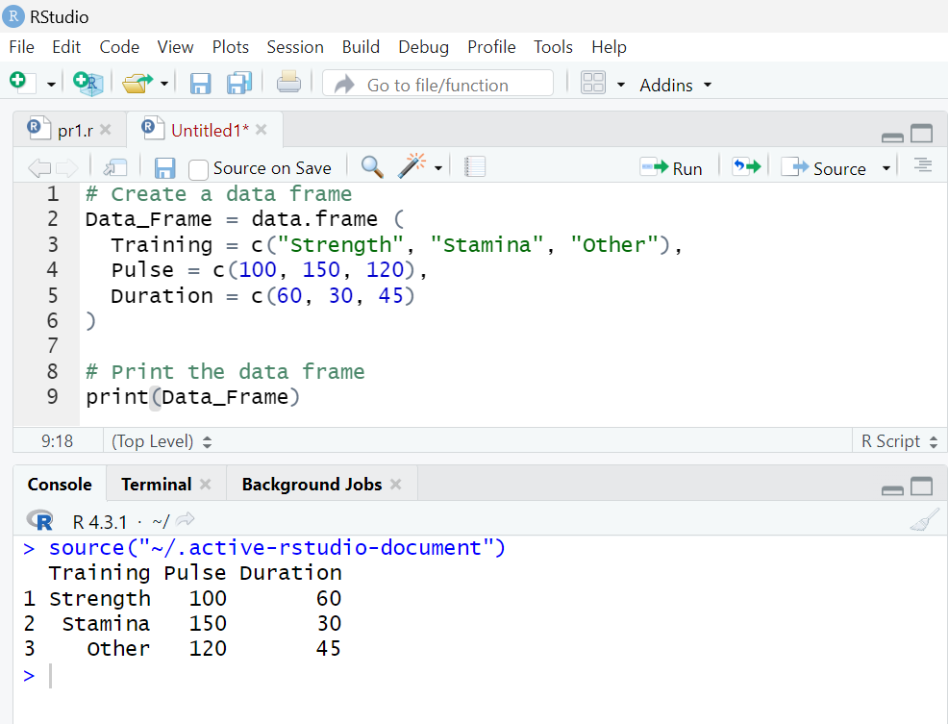
Data Frames
Data Frames are data displayed in a format as a table.
Data Frames can have different types of data inside it

Slide 27
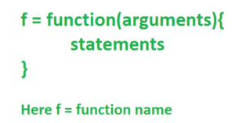
Function
A function accepts input arguments and produces the output by executing valid R commands that are inside the function.
Functions are useful when you want to perform a certain task multiple times.
In R Programming Language when you are creating a function the function name and the file in which you are creating the function need not be the same and you can have one or more functions in R.

Slide 28
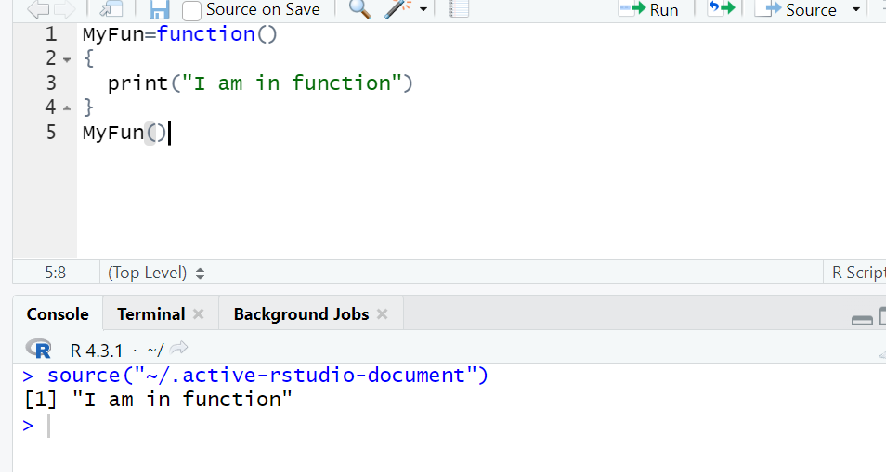
Parameters or Arguments in R Functions:
1. No argument

Slide 29
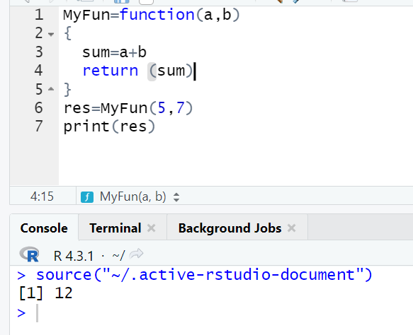
Adding Arguments in R

Slide 30
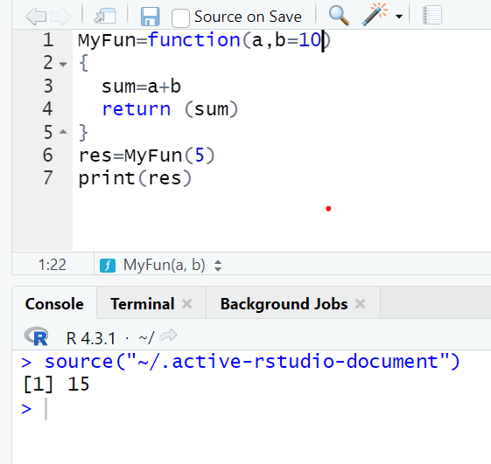
Adding Default Value in R

Slide 31
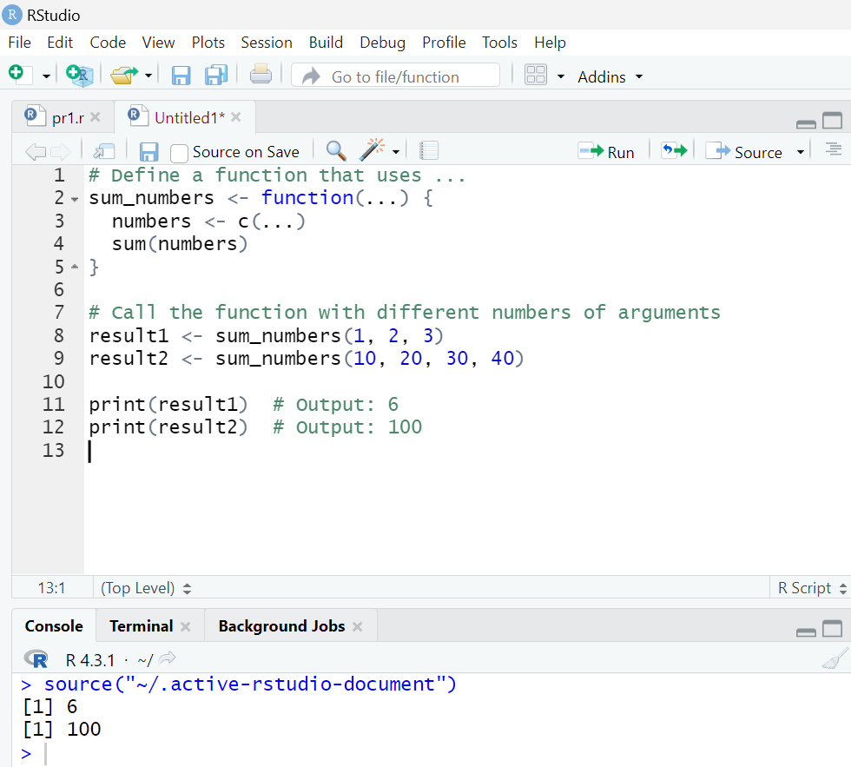
Dots Argument
Dots argument (…) is also known as ellipsis which allows the function to take an undefined number of arguments. It allows the function to take an arbitrary number of arguments.

Slide 32
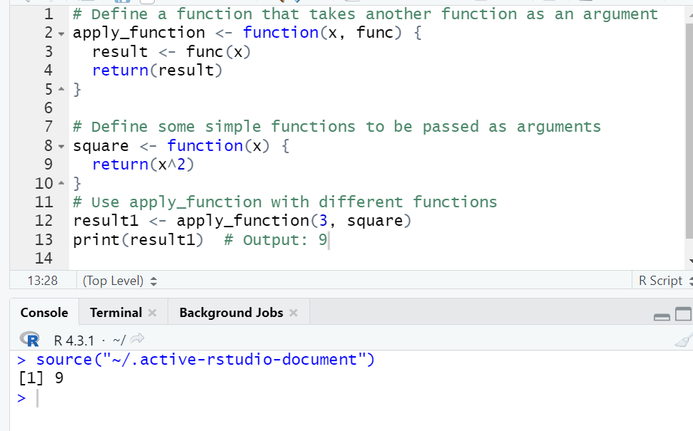
Function as Argument

Slide 33
R Programming : Bar Chart
Bar charts are a popular and effective way to visually represent categorical data in a structured manner.
Syntax:
barplot(H, xlab, ylab, main, names.arg, col)
Parameters:
H: This parameter is a vector or matrix containing numeric values which are used in bar chart.
xlab: This parameter is the label for x axis in bar chart.
ylab: This parameter is the label for y axis in bar chart.
main: This parameter is the title of the bar chart.
names.arg: This parameter is a vector of names appearing under each bar in bar chart.
col: This parameter is used to give colors to the bars in the graph.

Slide 34
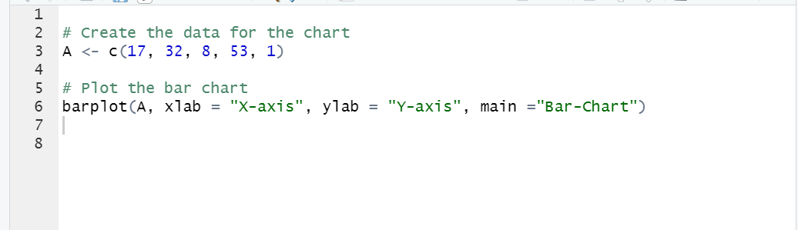
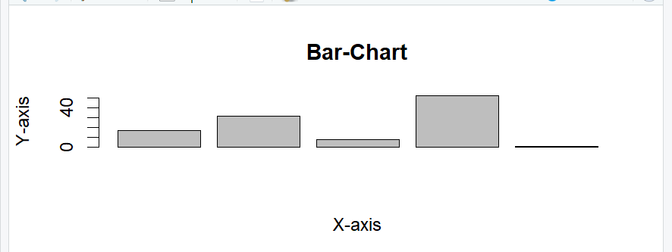

Slide 35
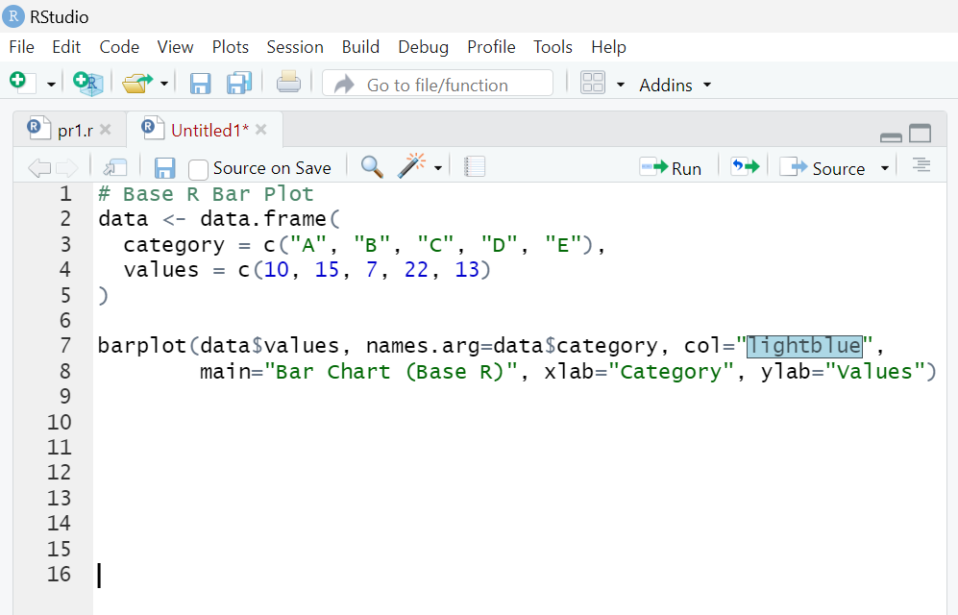
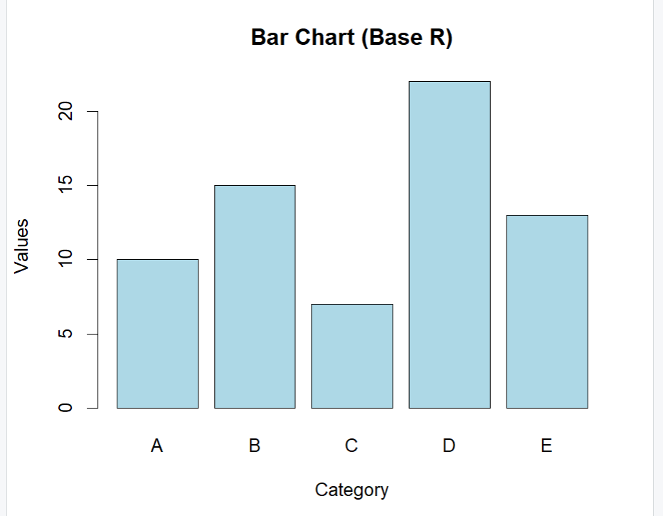

Slide 36
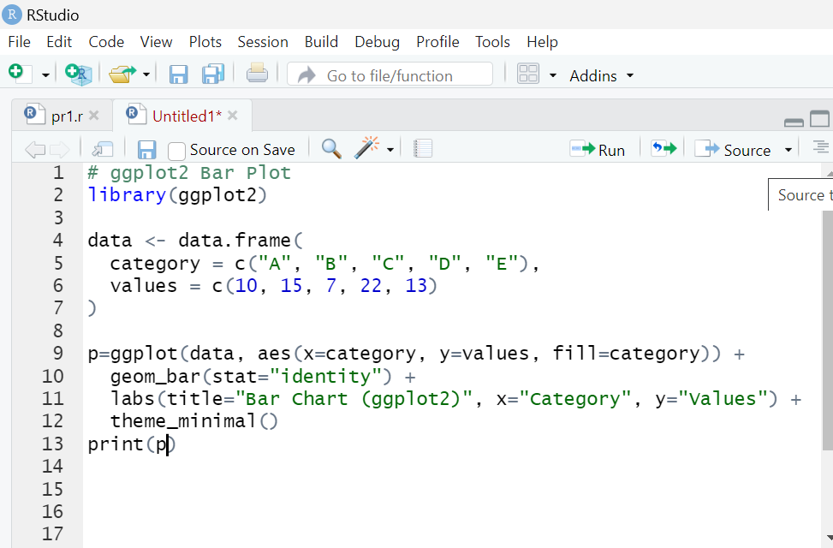
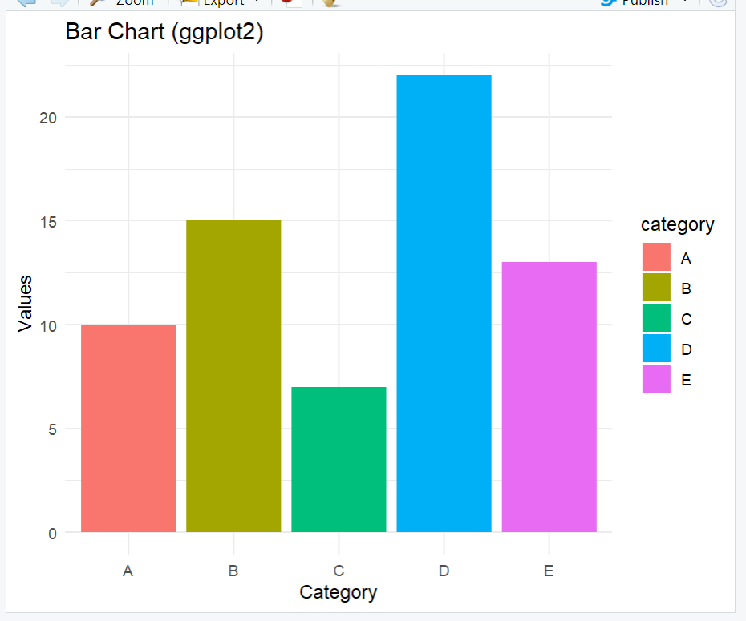

Slide 37
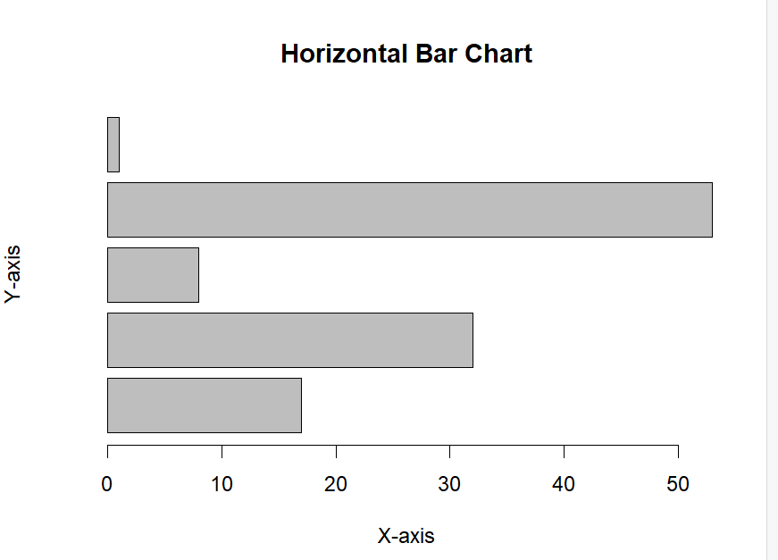
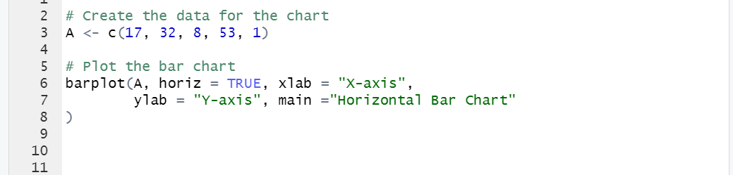
Creating a Horizontal Bar Chart in R
To create a horizontal bar chart:
Take all parameters which are required to make a simple bar chart.
Now to make it horizontal new parameter is added.barplot(A, horiz=TRUE )

Slide 38
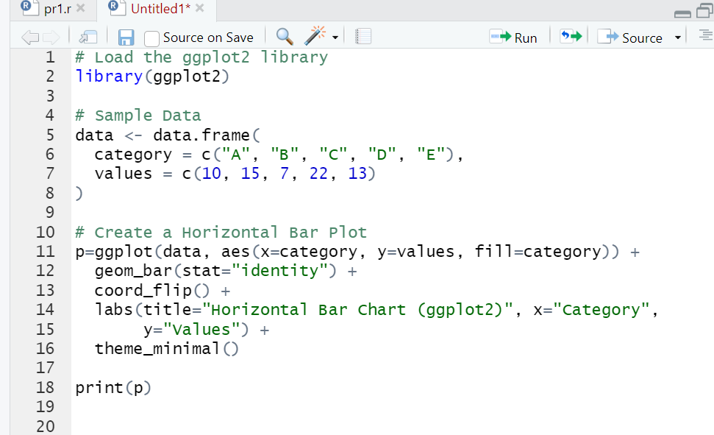
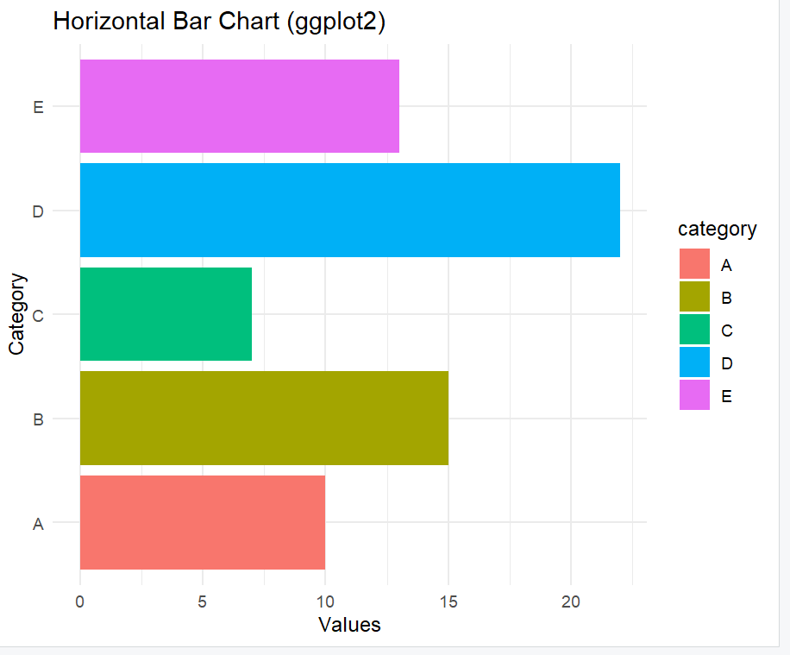

Slide 39
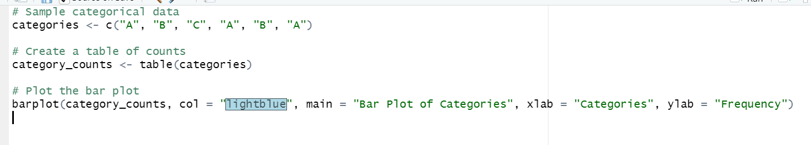
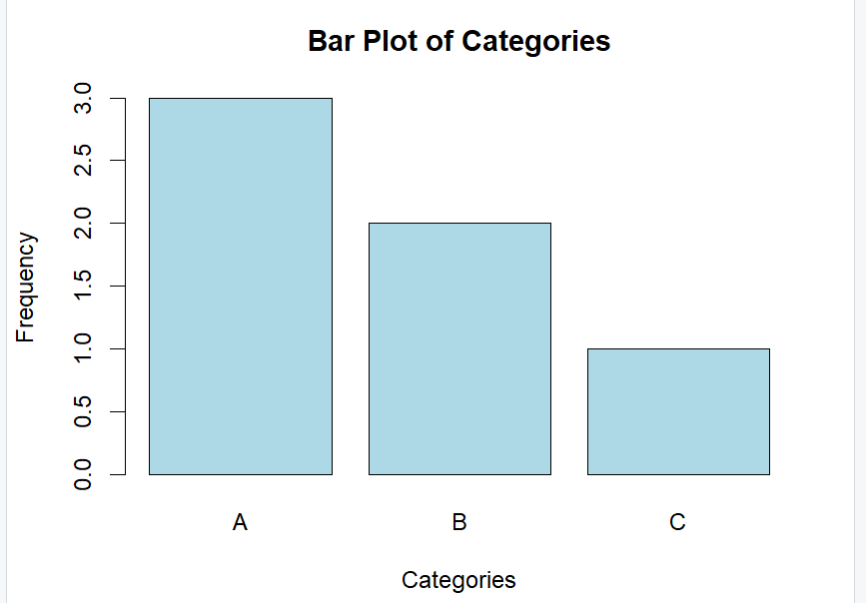
Plotting categorical data
Plotting categorical data in R involves visualizing data that is organized into categories. There are several types of plots that are particularly useful for displaying categorical data, including bar plots, box plots, and pie charts

Slide 40
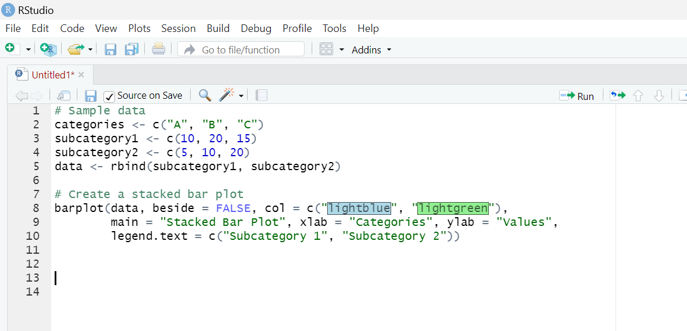
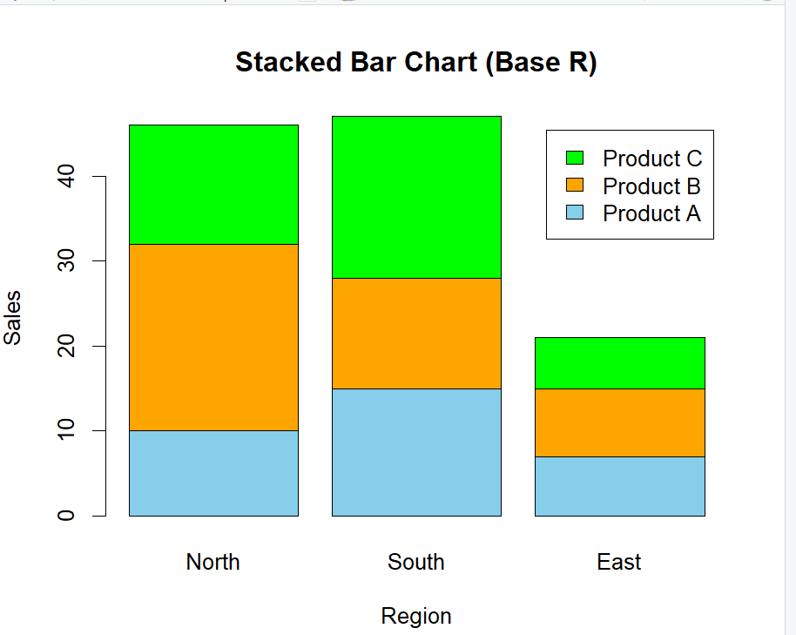
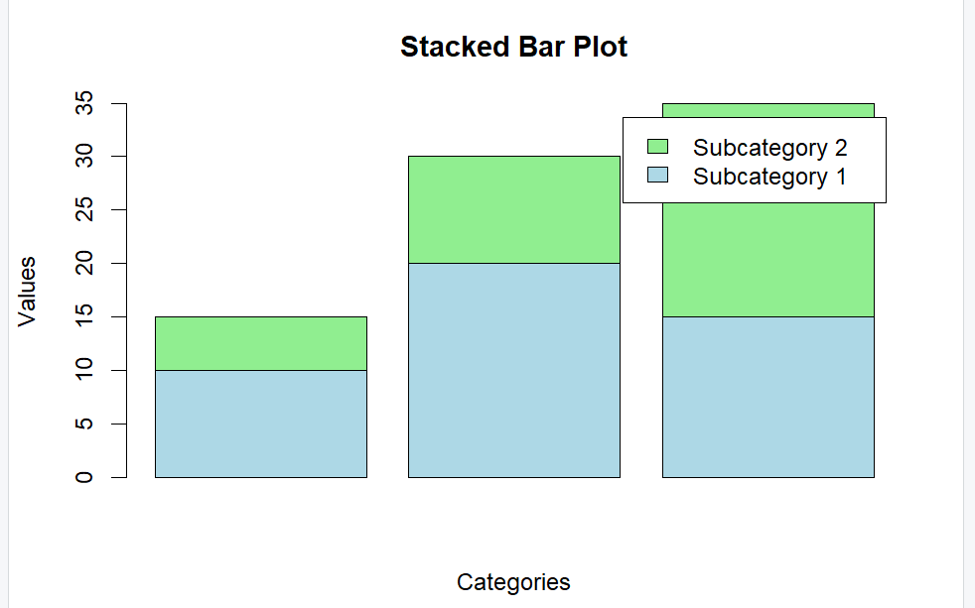
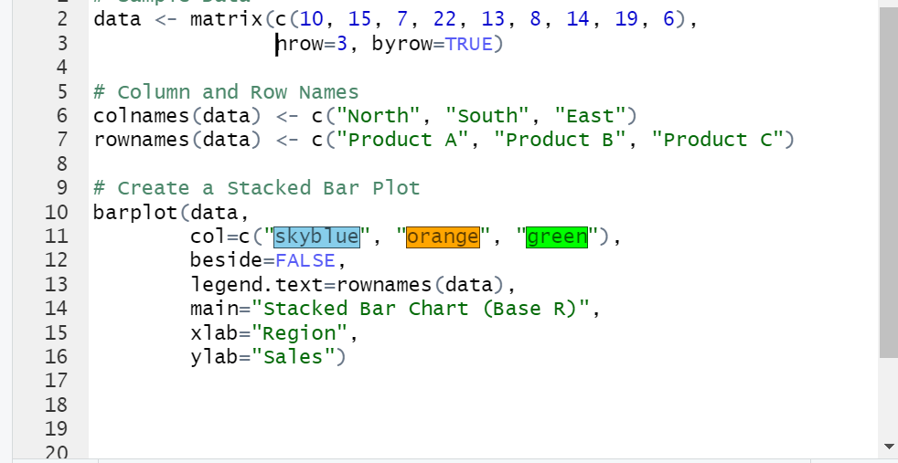
Stacked bar plot
A stacked bar plot is used to show the distribution of subcategories within each main category. It stacks the subcategories on top of each other within each category bar, allowing you to compare both the overall category sizes and the proportions of the subcategories.

Slide 41
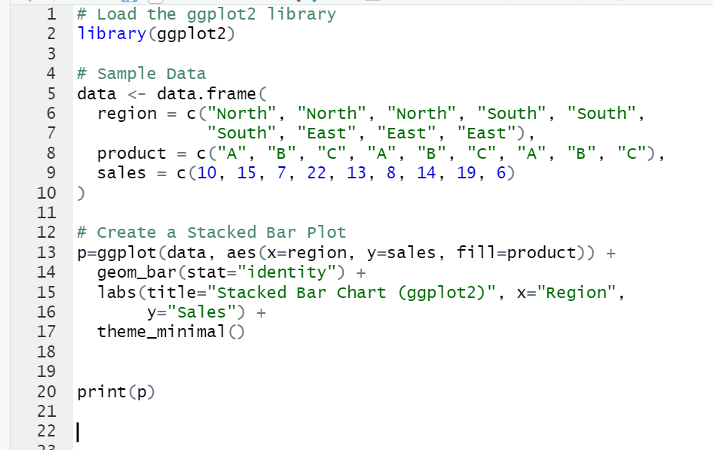
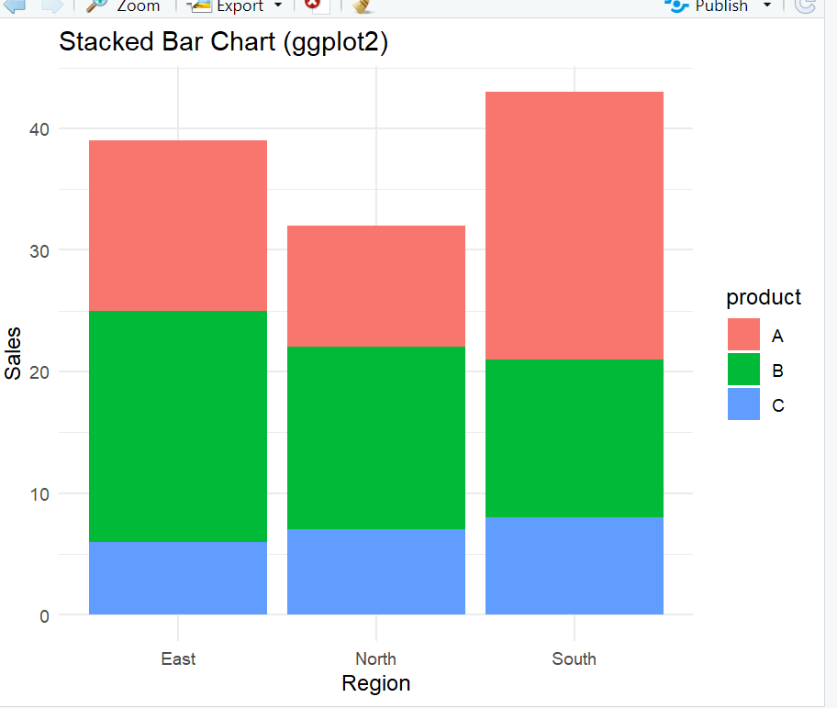

Slide 42
histogram
A histogram is a graphical representation of the distribution of a dataset. It groups data into bins (or intervals) and displays the frequency of data points within each bin as bars. Histograms are particularly useful for understanding the distribution of continuous data.

Slide 43
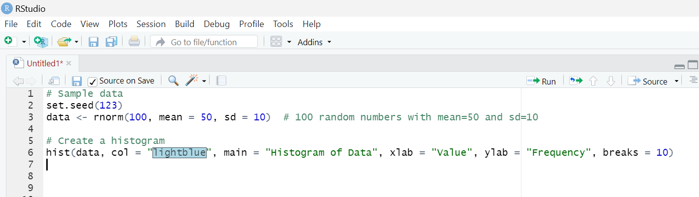
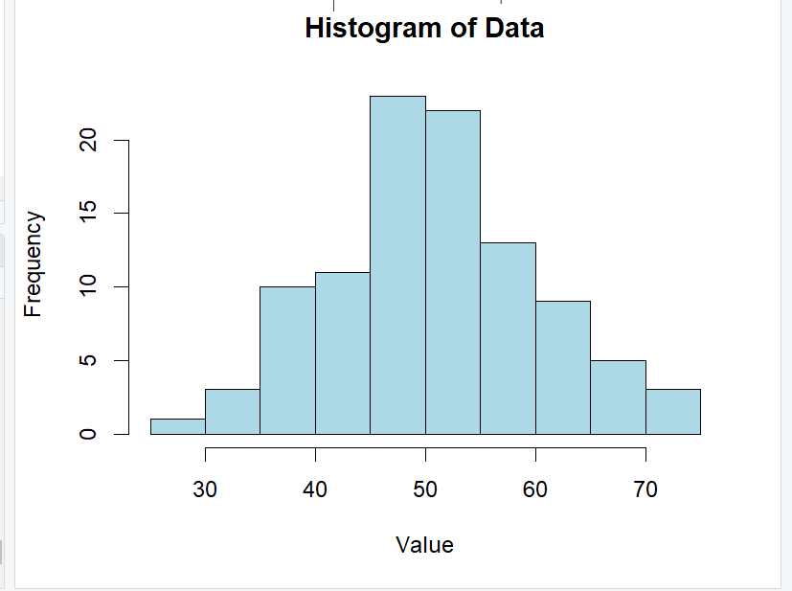

Slide 44
Plot()
The plot() function can be used to create simple plots by providing vectors of x and y values.

Slide 45
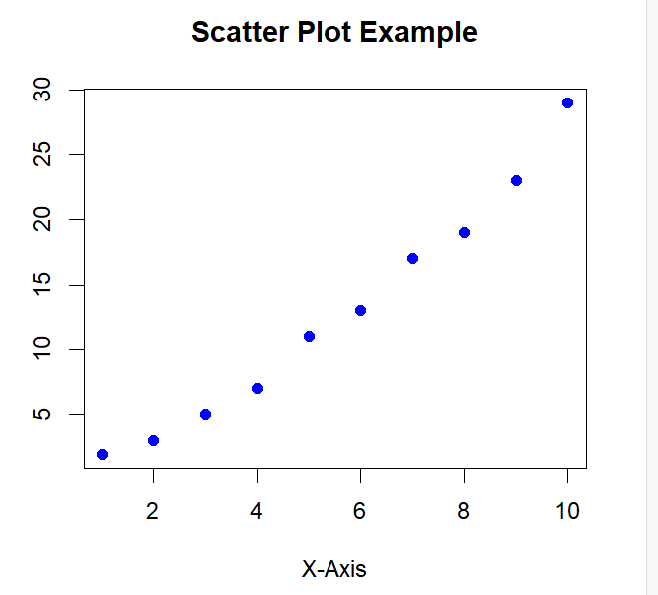
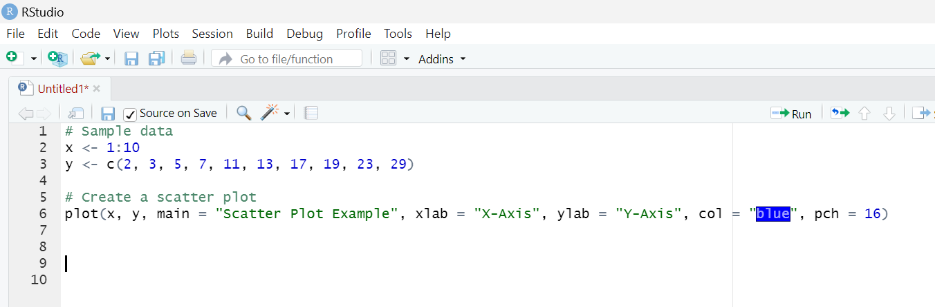
Basic Scatter Plot

Slide 46
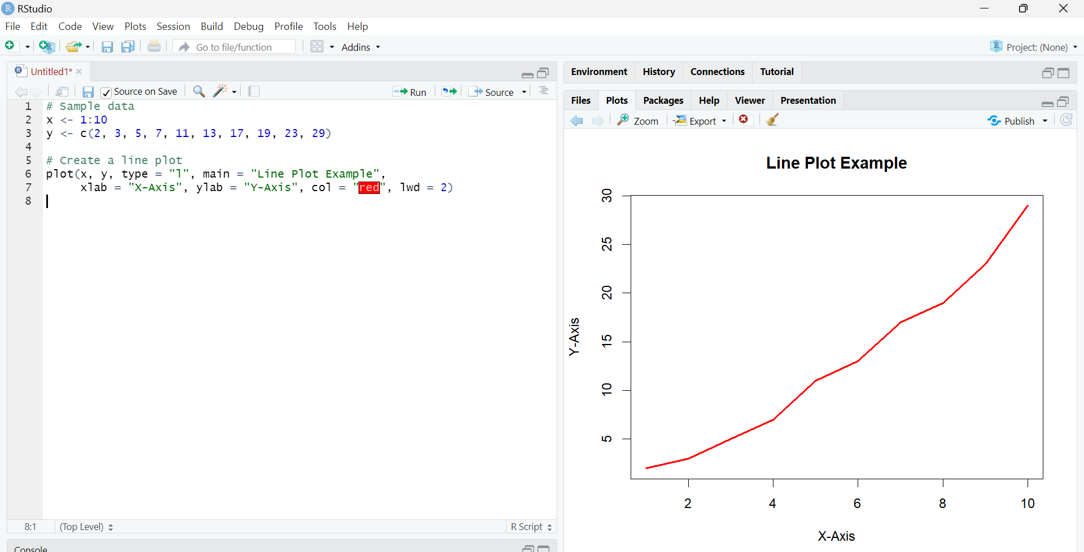
Line Plot

Slide 47
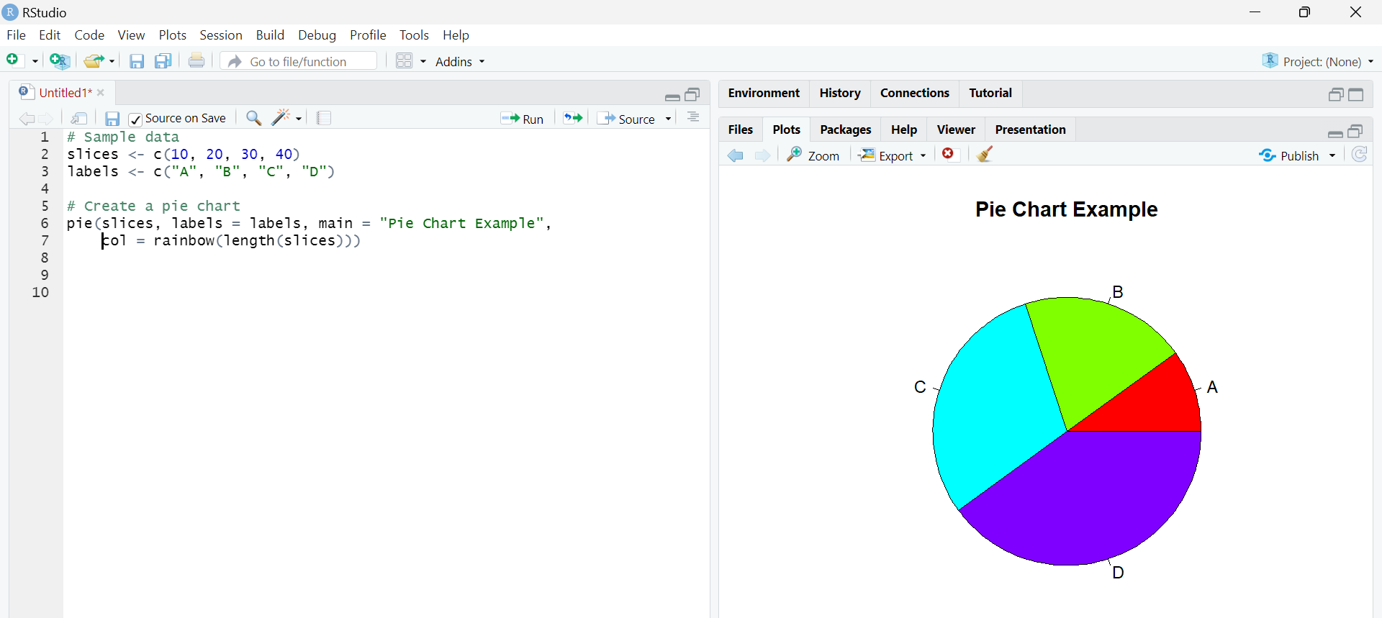
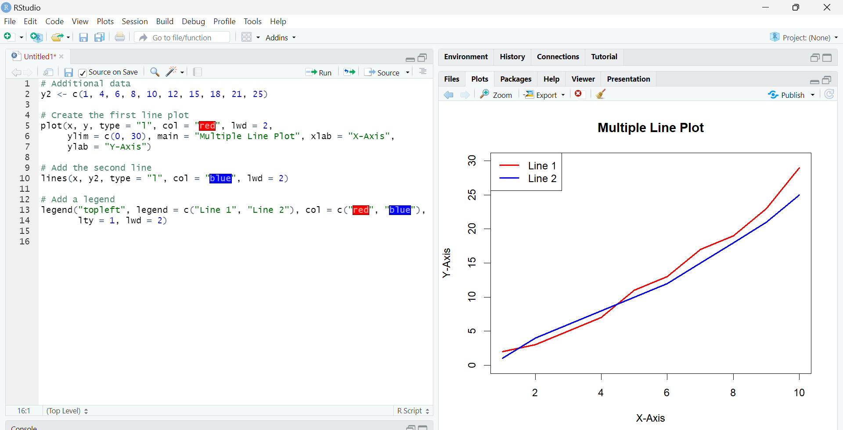
Multiple Line Plot

Slide 48
A box plot, also known as a box-and-whisker plot, is a standardized way of displaying the distribution of data based on a five-number summary: minimum, first quartile (Q1), median, third quartile (Q3), and maximum. It is particularly useful for identifying outliers and understanding the spread and skewness of the data.

Slide 49
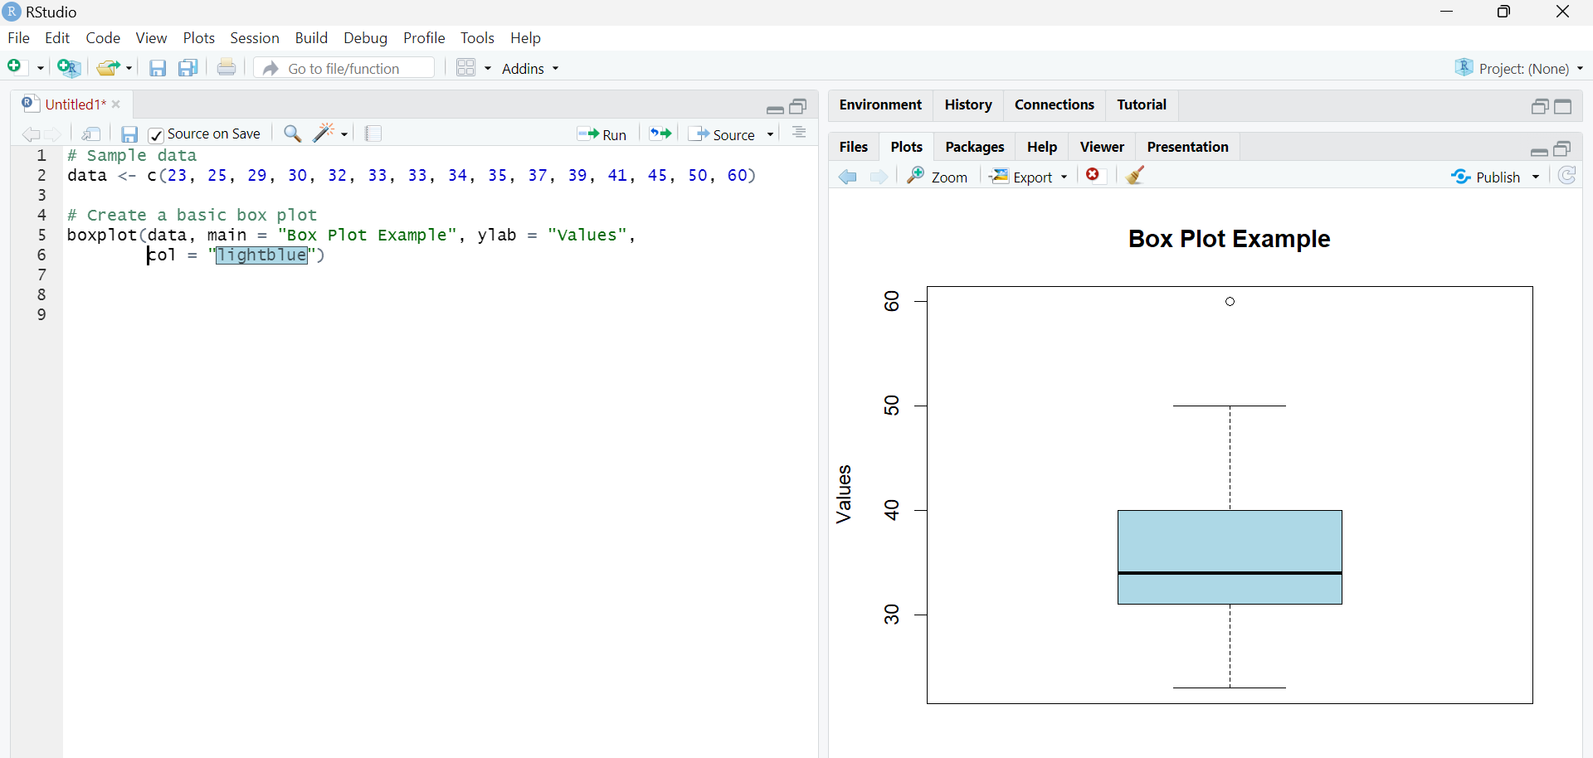
Box Plot

